Slide 2
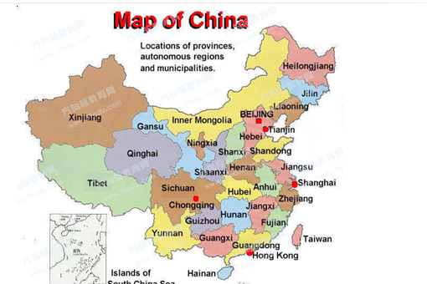
If China is the whole,
then, Shanghai is the part of China.

Slide 3
If Europe is the whole,
Then, … is the part of Europe.

Slide 4
If …….. is the whole, then ……. is the part of the whole.

Slide 5
If …….. is the whole, then ……. is the part of the whole.

Slide 6
The relationship between
a whole and the parts.
A whole can be divided into many parts.
Many parts can make one whole.

Slide 7
Work in pairs :
One say: If …….. is the whole, then ……. is the part of the whole.
The other judge

Slide 8
Homework
To find the relationship of the whole and part at home and say to your parents.

